Slide 1

AQua: An Energy-Efficient Water Quality Monitoring and Recording System
Researchers:
Daligdig, Arianne Dale O.
Fuentespina, Jane T.

Slide 2
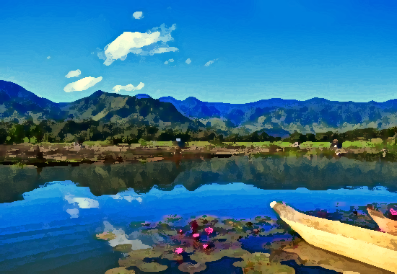
Introduction

Slide 3
Aquaculture
Globally - 179 million metric tons of fish were produced, of which 82 million were produced by aquaculture (FAO, 2020).
Philippines - 525.24 thousand metric tons volume of harvest
decreased by 0.2% from the 526.05 thousand metric tons (PSA, 2021).
Mindanao - about 2,869.78 metric tons were produced from aquaculture fisheries
15.2% lower compared to the catch of 3,382.20 metric tons (PSA-SOCCSKSARGEN, 2020).
Notes:
FAO 2020- page 19
PSA 2021- page 2
PSA-SOCCSKSARGEN- page 1

Slide 4
According to BFAR-PHILMINAQ, the fish perform all its physiological activities in the water – breathing, excretion of waste, feeding, and reproduction.
Thus, water quality is the determining factor in the success or failure of an aquaculture operation. The continued degradation of water resources due to anthropogenic sources necessitates an improvement in sites for aquaculture using water quality as a basis.
At present, aqua farmers rely on manual testing to determine water conditions; and it consumes time and produces inaccurate readings because water quality parameters may alter with time.

Slide 5
CAUSES:
Lack of clear responsibilities, overlapping institutional boundaries, duplication of work, and a lack of coordination among involved institutions.
Constrained somehow by available laboratory facilities, instruments, transportation, and human resources; and may collect data primarily through direct sampling or limited water quality parameters. (Japitana et al., 2018).
Specific information about water conditions, which is required to develop management strategies, is particularly scarce. (Deutsch et al., 2005)
Notes:
Inefficient water quality monitoring system

Slide 6
With this, the researchers proposed a study that builds a portable and energy-efficient on-site water quality monitoring and recording system that can deliver real-time data to the aqua farmers and government officials and record the current environmental status of the aquaculture sites for further analysis. This project will help prevent the water parameters from fluctuating to a dangerous level that affects the mortality rate of the organism. Also, this will help in addressing the decline of the production of fish in selected provinces in Mindanao, Philippines.

Slide 7
Statement of the Problem

Slide 8
This research is conducted to provide an automated system of monitoring and recording water quality using Arduino. Specifically, this research aims to answer the following questions:
How accurate are the readings of the sensors used when exposed to a wide range of conditions?
1.1 Acidic and basic for pH and oxidation-reduction potential
1.2 Hot and cold for temperature and dissolved oxygen
1.3 Saline and non-saline for total dissolved solid
1.4 Turbid and clear for turbidity
Notes:
Accuracy - Compare the Aqua readings to a lab tester (Statistical tool: Percent Difference/Error)
Cold water means more dissolved oxygen than warm water.
Temp low=DO concentration high
Temp high=DO concentration low
Oxygen Reduction Potential:
ph low=ORP high
ph high=ORP low
Turbidity is the measure of relative clarity of a liquid.
Saline is the solution of salt in water.

Slide 9
2. Is the AQua effective in terms of:
2.1 Speed and range of data transmission
2.2 Power efficiency

Slide 10
Objectives

Slide 11
General
The main objective of this research is to develop real-time water quality progress reports for water treatment ensuring safe natatory environment for aquaculture using Arduino.
Specific
This research project aims to achieve the following:
Design and construct the AQua device using Arduino Uno.
Monitor and measure the water pH, temperature, dissolved oxygen, total dissolved solids, oxidation reduction potential and turbidity using available sensors at remote places.

Slide 12
Assess the accuracy of the results when applied to a wide range of water conditions and different water samples.
Avail local power supply to sensor nodes using solar energy and collect the data from various sensor nodes and send it to base stations by a wireless channel which are connected using Wireless Sensor Network technology like Zigbee.
Simulate and analyze the quality parameters for quality control using ThingSpeak and publish the corresponding record over the web for public information and further assessment of water resources.

Slide 13
Significance of the Study

Slide 14
Essential to addressing food production, restoration of threatened and endangered species populations, wild stock population enhancement, the building of aquariums, fish cultures, and habitat restoration.
Increased rural employment and livelihood. Associated with its rise, however, are compounding problems brought by poor water quality.
Due to this, our project aims to aid in the rapid transmission of water parameter data to specified local government officials and specialists, that is to say, critical in the water treatment decision-making and action-taking process.
Notes:
Water Quality Monitoring must be a continuous joint effort by the government, research institutions, and the industry.

Slide 15
Scope and Delimitations

Slide 16
This project's main objective is to create an onsite and energy-efficient IoT-based water quality monitoring and recording system using an Arduino Uno.
It focuses mainly on the sensor's and device's accuracy in contrast to typical laboratory equipment and the speed and range of data transmission via Zigbee module interface.
Only the pH, temperature, total dissolved solids, dissolved oxygen, redox potential and turbidity of the water will be measured by the device.
Notes:
Any suggestions for improving the device's stability and strength of the material will be taken into consideration for future research studies. In case of rejection from the aqua culturing sites aforementioned, we are going to try convincing the other registered aquaculture farms in Region 12.

Slide 17
The study's threshold values are solely based on Department of Environment and Natural Resources' (DENR) standard levels.
This device is solely for determining the water quality of aquaculture industries in selected sites in Mindanao.
Notes:
Any suggestions for improving the device's stability and strength of the material will be taken into consideration for future research studies

Slide 18
Theoretical Framework

Slide 19
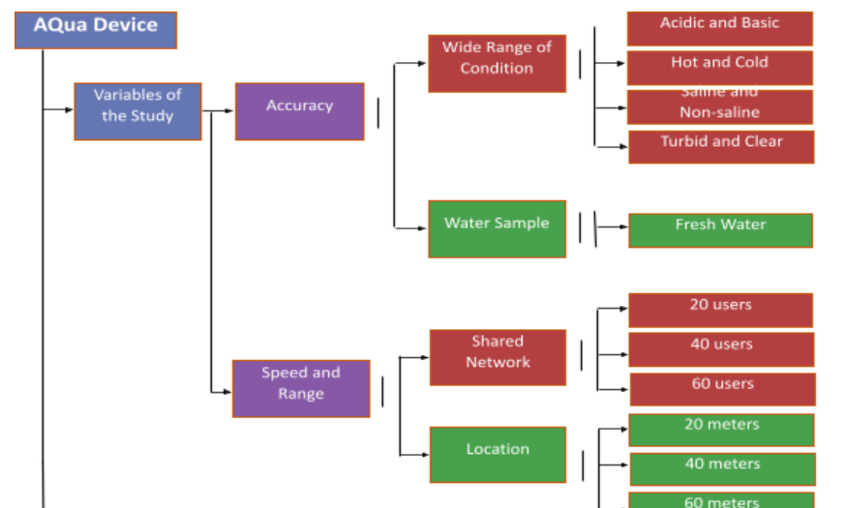

Slide 20
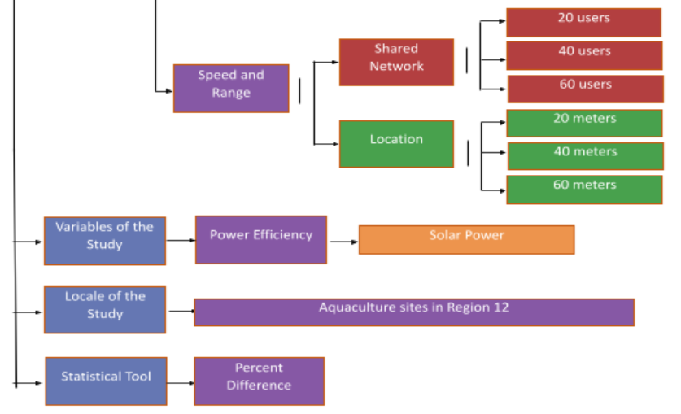

Slide 21
Related Literatures

Slide 22
Aquaculture
Aquaculture is the world's fastest-growing food-production sector. It is the practice of raising, breeding, and harvesting aquatic animals and plants in controlled aquatic environments such as oceans, lakes, rivers, and streams. It also has inherent features that make it one of the most cost-effective and low-impact methods of producing high-quality protein for humans. Compared to traditional animal agricultural methods, these advantages include a significantly higher food conversion efficiency. All systems, on the other hand, must provide the same ecological functions, such as maintaining an acceptable culture temperature, ensuring enough oxygen levels, and removing dangerous waste products (Tidwell & Bright, 2018; Schramm & Grist, 2021).

Slide 23
Fishkill
According to the BFAR, fishkill is defined as the "massive destruction of fish stocks in a specific area due to unacceptable or toxic water quality conditions in a specific aquatic environment." Some cases are caused by human activities, but natural causes account for roughly half of all cases worldwide. Some of the most common reasons include algal blooms and the related water quality issues, such as low oxygen or toxin development (Vera-ruiz, 2021).

Slide 24
Solar Energy Harvesting System
The extraction of energy from renewable energy sources is referred to as energy harvesting. It's a type of embedded system found in WSNs that's used to solve energy-related issues like scarcity. Solar energy can be harvested from artificially created or naturally occurring light. The efficiency of this technology is determined by the type of photovoltaic (or solar) cell used. Thin film, mono-crystalline, and poly-silicon photovoltaic cells are examples of solar cells. It's worth noting that mono-crystalline technology is often used due to its high energy conversion efficiency, which is typically less than 25%. (Olatinwo and Joubert, 2018).

Slide 25
ThingSpeak Server
ThingSpeak is an IoT data collection platform used for analyzing, examining, and visualizing water quality sensor values that have been uploaded to the cloud, such as pH, turbidity, voltage, temperature, distance, and so on. The data collector collects data from edge node devices and also allows for data modification for historical data analysis in a software environment. The core component of ThingSpeak activity is the channel, which has data fields and a status field. Data is updated, analyzed, and interpreted with MATLAB code when a ThingSpeak channel is created, and the data is reacted to with tweets and other notifications ( Das and Jain, 2017; Simitha and Raj, 2019)

Slide 26
Water Parameters
Chemical, physical, and biological characteristics of water can all be evaluated or monitored depending on the desired water parameters of interest. Temperature, dissolved oxygen, pH, conductivity, ORP, and turbidity are among parameters that are routinely measured or monitored for water quality.
Dissolved Oxygen
Because it is linked to breathing, dissolved oxygen is the most crucial factor in maintaining fish survival. Low quantities of dissolved oxygen can degrade the quality of refined water, disrupt growth, and put the body at danger of illness.

Slide 27
Diffusion from the atmosphere into the water, as well as diffusion from algae photosynthesis in the water, provide dissolved oxygen. The efficiency with which the diffusion process from air to water was carried out has an impact on water quality. The concentration of dissolved oxygen must be increased. The greater the water quality, the higher the dissolved oxygen concentration (Mahasri et al., 2018; Omer, 2019).

Slide 28
Water Parameters
Oxygen-reduction Potential
The ability of a lake or river to cleanse itself or break down waste products such as pollutants and dead plants and animals is measured by its oxidation-reduction potential (ORP). When the ORP value is high, the water contains a lot of oxygen. Bacteria that break down dead tissue and pollutants will be able to work more efficiently as a result. The greater the ORP rating, the healthier the lake or river is in general. Even in healthy lakes and rivers, however, as you move closer to the bottom sediments, there is less oxygen. This is because numerous bacteria in the sediments are working hard to break down dead tissue, and they consume a lot of the oxygen available (Sallenave, 2013).

Slide 29
Water Parameters
pH
Extremely low or extremely high pH water is fatal. Only a few organisms can survive in water with a pH of below three or beyond eleven, and most fish will die if the pH is below four or above ten. Water that is somewhat acidic (low pH) can diminish the number of hatched fish eggs, irritate fish and aquatic insect gills, and damage membranes (Omer, 2019).

Slide 30
Water Parameters
Temperature
The temperature of water is one of its most basic properties, and many other factors rely on it for accuracy. We can use temperature data to monitor thermal loading or discharge, as well as measure changes in the thermocline, which has an impact on the health of aquatic animals and critters. Many aquatic organisms are harmed by high temperatures because less oxygen dissolves in the water, clouds prohibit plants from creating enough oxygen through photosynthesis, and calm breezes inhibit turbulence and mixing of atmospheric oxygen with surface water. Warmer water has a lower oxygen solubility, which reduces oxygen delivery. Furthermore, because larger fish demand more oxygen than smaller fish, they usually perish first (Sallenave, 2013)

Slide 31
Water Parameters
Total Dissolved Solid
Total dissolved solids (TDS) are the sum of all ion particles less than 2 microns, according to the Fondriest Environmental Learning Center (2019). (0.0002 cm). All of the disassociated electrolytes that make up salinity concentrations, as well as other substances such dissolved organic matter, are included. TDS is roughly equal to salinity in "clean" water. TDS can comprise organic solutes (such as hydrocarbons and urea) in addition to salt ions in wastewater or contaminated environments. Excessive total dissolved solids can be hazardous to fish and fish eggs depending on their ionic characteristics.

Slide 32
Water Parameters
Turbidity
Suspended particles can block or harm fish gills, reducing disease resistance, growth rates, egg and larval maturation, and the efficacy of fish capture methods. Higher turbidity boosts water temperatures, which limits the amount of accessible food, because suspended particles absorb more solar heat. As a result, the concentration of dissolved oxygen (DO) can be lowered since warm water carries less dissolved oxygen than cold water (Omer, 2019).

Slide 33
Water Pollution
Pesticides, heavy metals, and hydrocarbons, among other potentially dangerous compounds, are frequently introduced into the aquatic environment. When huge amounts of pollutants are released, there may be an immediate impact, as seen by large-scale abrupt mortalities of aquatic animals, such as fish kills caused by agricultural pesticide contamination of waterways. Lower discharge levels could lead to a buildup of contaminants in aquatic creatures. Immunosuppression, impaired metabolism, and damage to the gills and epithelia are some of the end effects, which can occur long after the pollutants have gone through the environment (Demeke, and Tassew, 2016)

Slide 34
Wireless Sensor Network Technology
Recent technologies in wireless communications and electronics have brought the vision of Wireless Sensor Network (WSN) into reality which have increased the growth of low cost, low power and multi-functional sensors that are small in size and can communicate in short range. Each node consists of microcontrollers, memory and transceiver. The microcontrollers are used to execute tasks, data processing and assist the functionality of other components in the sensor node. For the memory, it is mainly used for data storage while the transceiver acts from the combination of transmitter and receiver functions.

Slide 35
Wireless Sensor Network Technology
Natural phenomena data such as temperature, light, sound and pressure are collected by sensors and then transmitted to a server. These battery powered nodes are used to monitor and control the physical environment from remote locations. In the past few years, the applications of Wireless Sensor Network have been widely used and applied in medical, military, industrial, agricultural and environmental monitoring (Mohd, 2011)

Slide 36
Zigbee Module
ZigBee is a standard protocol that combines the physical Radio Frequency (RF) layer with the IEEE 802.15.4 physical radio specification and operates in unlicensed bands such as 2.4 GHz, 900 MHz, and 868 MHz [4,8]. Except for the GSM modem network, this project utilised the 2.4 GHz ISM frequency band for all nodes. ZigBee's smart, cost-effective, and energy-efficient mesh network is defined by the core ZigBee specification. It's a self-configuring, self-healing system of redundant, low-cost, very low-power nodes that allows ZigBee to have its distinctive flexibility, mobility, and ease of use. WSN futures will also have an energy-saving coverage due to its tiny size and battery life dependence, which is limited to be powered. As a result, the 'active' and 'hibernation' nodes will aid in power conservation (Nasirudin et al, 2011)

Slide 37
Methodology
Notes:
The goal of the research is to develop an onsite and energy-efficient water quality monitoring and recording system with a notification system. To accomplish this, the development was divided into 4 parts: (1) The designing of the device, (2) the assembly of the main circuitry, (3) the construction of the device chassis, and (4) the accuracy tests.

Slide 38
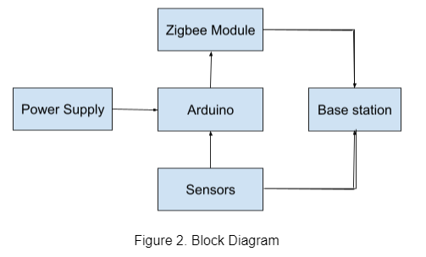
System Design and Layout
Notes:
The sensors, the microcontroller (Arduino Uno), the base station (ThingSpeak), the Zigbee module, and the solar power supply are the five primary components of the AQua device. The pH sensor, temperature sensor, TDS sensor, dissolved oxygen sensor, oxidation-reduction potential sensor, and turbidity sensor are the sensors used in this study. The data collected by the sensors is sent to the base stations by a wireless sensor network technology called Zigbee. The Zigbee module will be used to connect the nodes and base station. The data obtained by various sensors on the node side will be sent to the base station where the data can be displayed in a visual manner and analyzed using ThingSpeak. Then, the corresponding records will be published over the web for public information and further assessment of water parameters.

Slide 39
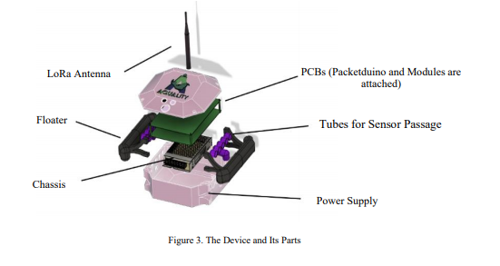
Construction and Assembly
Notes:
The AQua device contains six sensors (namely the pH sensor, the temperature sensor, the total dissolved solids sensor, dissolved oxygen sensor, oxidation-reduction potential sensor, and the turbidity sensor) which are connected to one main microcontroller (Arduino Uno) together with the Zigbee module. The case of the device is box-shaped and will be made out of acrylic due to its low cost material, water resistance ability, and well-known availability. It houses all the main parts of the device. The two tubes on each side function as a floating device. The pipes on each side are outlets for the sensor and are covered by mesh to avoid fish eating the sensors or bumping into them. Figure 3 shows the inspiration of the AQua device related to its illustration and its parts.

Slide 40
Device Accuracy Tests
The collected data was compared against the traditional way of data gathering for each parameter to ensure that the results were credible. To be considered accurate, each datum obtained by the gadget must be within 5% of the traditional method’s test findings (Alave et al, 2020).

Slide 41
References
Das, B., & Jain, P. C. (2017, July). Real-time water quality monitoring system using Internet of Things. In 2017 International conference on computer, communications and electronics (Comptelix) (pp. 78-82). IEEE.
Demeke, A., & Tassew, A. (2016). A review on water quality and its impact on fish health. International journal of fauna and biological studies, 3(1), 21-31.
Deutsch, W. G., Busby, A. L., Orprecio, J. L., Bago-Labis, J. P., & Cequina, E. Y. (2005). Community-based hydrological and water quality assessments in Mindanao, Philippines. Forests Water & People in the Humid Tropics, 134-149.
FAO. (2020). STATE OF WORLD FISHERIES AND AQUACULTURE 2020 : sustainability in action. Food & Agriculture Org.
FISH KILL: Why do they occur? (2021, January 6). Manila Bulletin. https://mb.com.ph/2021/01/06/fish-kill/
Fisheries Situation Report, January to arch 2021 | Philippine Statistics Authority. (n.d.). Psa.gov.ph. Retrieved December 15, 2021, from https://psa.gov.ph/content/fisheries-situation-report-july-september-2021-0

Slide 42
References
Fondriest Environmental, Inc. (2014). Conductivity, Salinity & Total Dissolved Solids - Environmental Measurement Systems. Environmental Measurement Systems. https://www.fondriest.com/environmental-measurements/parameters/water-quality/conductivity-salinity-tds/
Mahasri, G., Saskia, A., Apandi, P. S., Dewi, N. N., & Usuman, N. M. (2018, April). Development of an aquaculture system using nanobubble technology for the optimation of dissolved oxygen in culture media for nile tilapia (Oreochromis niloticus). In IOP Conference Series: Earth and Environmental Science (Vol. 137, No. 1, p. 012046). IOP Publishing.
Mohd. Ezwan Jalil. (2011). Positioning and Location Tracking Using Wireless Sensor Network (Doctoral dissertation, Universiti Teknologi Malaysia).
Nasirudin, M. A., Za'bah, U. N., & Sidek, O. (2011, September). Fresh water real-time monitoring system based on wireless sensor network and GSM. In 2011 IEEE Conference on Open Systems (pp. 354-357). IEEE.

Slide 43
References
Fondriest Environmental, Inc. (2014). Conductivity, Salinity & Total Dissolved Solids - Environmental Measurement Systems. Environmental Measurement Systems. https://www.fondriest.com/environmental-measurements/parameters/water-quality/conductivity-salinity-tds/
Mahasri, G., Saskia, A., Apandi, P. S., Dewi, N. N., & Usuman, N. M. (2018, April). Development of an aquaculture system using nanobubble technology for the optimation of dissolved oxygen in culture media for nile tilapia (Oreochromis niloticus). In IOP Conference Series: Earth and Environmental Science (Vol. 137, No. 1, p. 012046). IOP Publishing.
Mohd. Ezwan Jalil. (2011). Positioning and Location Tracking Using Wireless Sensor Network (Doctoral dissertation, Universiti Teknologi Malaysia).
Nasirudin, M. A., Za'bah, U. N., & Sidek, O. (2011, September). Fresh water real-time monitoring system based on wireless sensor network and GSM. In 2011 IEEE Conference on Open Systems (pp. 354-357). IEEE.
back

Slide 44
References
Olatinwo, S. O., & Joubert, T. H. (2018). Energy efficient solutions in wireless sensor systems for water quality monitoring: A review. IEEE Sensors Journal, 19(5), 1596-1625.
Omer, N. H. (2019). Water quality parameters. Water quality-science, assessments and policy, 18.
Sallenave, R. (2013). Understanding and preventing fish kills in your pond. NM State University, Cooperative Extension Service.
Schramm, D., & Grist, C. (2021). BUILDING SITE SELECTION TO CONSERVE ENERGY BY OPTIMIZING TOPOCLIMATIC BENEFITS: A Possible Use for Computer-Based Data Manipulation and Mapping Systems. In Energy Resources and Conservation Related to Built Environment (pp. 308-318). Pergamon.
Simitha, K. M., & Raj, S. (2019, June). IoT and WSN based water quality monitoring system. In 2019 3rd International conference on Electronics, Communication and Aerospace Technology (ICECA) (pp. 205-210). IEEE.
SOCCSKSARGEN REGION’s 2nd QUARTER 2020 FISHERIES PRODUCTION UP BY 23.0 PERCENT | Philippine Statistics Authority SOCCSKSARGEN Region. (2020). Psa.gov.ph.http://rsso12.psa.gov.ph/article/soccsksargen-region%E2%80%99s-2nd-quarter-2020-fisheries-production-230-percent
Tidwell, J. H., & Bright, L. A. (2019, January 1). Freshwater Aquaculture (B. Fath, Ed.). ScienceDirect; Elsevier. https://www.sciencedirect.com/science/article/pii/B9780124095489106189

Slide 45
References
@article{kaur_gambhir_kumar_2016, title={Arduino based solar powered battery charging system for rural SHS}, DOI={10.1109/iicpe.2016.8079373}, journal={2016 7th India International Conference on Power Electronics (IICPE)}, author={Kaur, Tarlochan and Gambhir, Jaimala and Kumar, Sanjay}, year={2016}}

